Slide 1
Silences in policy?
Kay Tisdall, Co-Director
Centre for Research on Families and Relationships (CRFR) University of Edinburgh

Slide 2
From Peter’s slides …
“Intersectionality was introduced in the late 1980s as a heuristic term to focus attention on the vexed dynamics of difference and the solidarities of sameness in the context of antidiscrimination and social movement politics. It exposed how single-axis thinking undermines legal thinking, disciplinary knowledge production, and struggles for social justice” (Cho, Crenshaw and McCall 2013, 787).
Notes:
http://www.scottishinsight.ac.uk/Programmes/Programmes201314/ChildrensRights.aspx
(My own emphasis)

Slide 3
Ssshhh…
Age discrimination
Children and young people’s participation
The universalism of GIRFEC

Slide 4
It is important that services for children are tailored in an age-appropriate way – a child of three is very different from a child of ten, or a teenager. The basic principle of age discrimination legislation, that people should not be treated differently on the basis of their age, is therefore rarely appropriate to the treatment of children ... Furthermore, legislation might encourage providers of services to standardise provision across all age groups even if this was not the intended outcome. This could clearly operate to the detriment of children. (DCLG 2007: para 9.26-9.27)

Slide 5

Notes:
Image from https://www.flickr.com/photos/lydiashiningbrightly/3030594722/

Slide 6
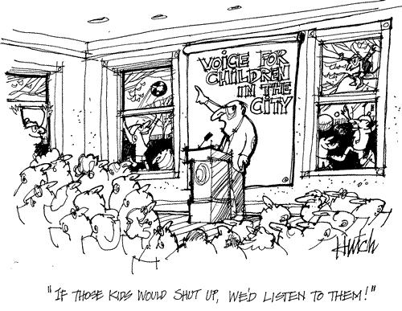
Notes:
Cartoon by Stu Hutchinson, used with permission.

Slide 7
Take 2 minutes to talk to the person next to you (say hello!)
Come up with 1-2 common challenges, for children and young people’s participation in decision-making to be effective
Be prepared to mention one to the group

Slide 8
Voice against Violence
http://vimeo.com/46353009

Slide 9
Getting it Right for Every Child (GIRFEC)
Notes:
http://www.scotland.gov.uk/Topics/People/Young-People/gettingitright/national-practice-model

Slide 10

Notes:
http://pixabay.com/en/megaphone-loudspeaker-speech-talk-155780/

Slide 11
If you want more information …
On our Continuing Professional Development courses, on research/involving children and young people http://www.crfr.ac.uk/catch-the-early-bird-rate-for-cpd-courses-now/
On our MSc in Childhood Studies http://www.sps.ed.ac.uk/pgtcs
On our recently published book, Children and Young People’s Participation and Its Transformative Potential: Learning from across Countries.

